Slide 1

Team Venom

Slide 2
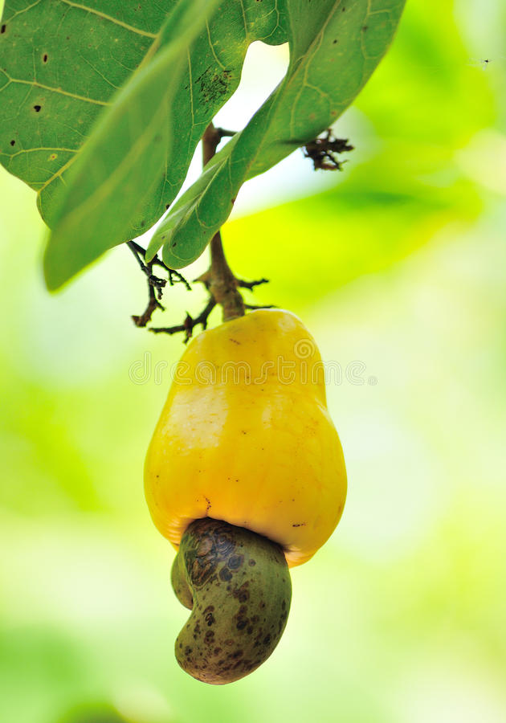

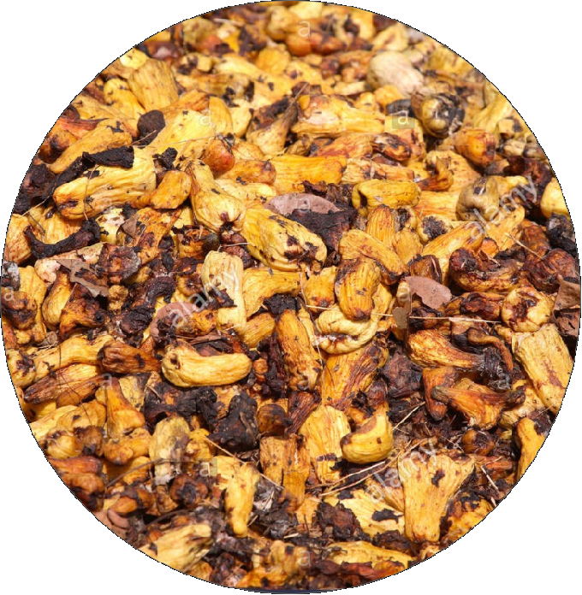

PROBLEM STATEMENT
The lack of utilization of cashew apple

Slide 3

SOLUTION
We will buy these apples from farmers
Cashew Apples
Pressing
Cashew Juice
fermentation
filteration
fiteration
packaging
distilation
packaging

Slide 4




OUR COMPETITIVE ADVANTAGE
market info
partner
online market
made in Ghana
Web app
Mobile app
Local
Breweries

Slide 5

ENTER TITLE
ENTER TITLE
add you text here add you text
add you text here add you text

Slide 6
Marketing Strategy
Social Media Campaign
Promotional discounts
Face to face marketing
The use of Leads
Radio talk show

Slide 7

REVENUE MODEL
Paid advertisement on our platforms.
Transactional fees charged on orders.
Commission on products purchased.

Slide 8
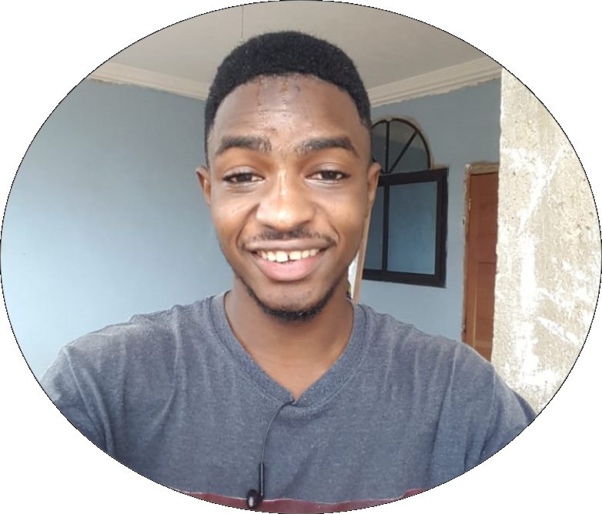

TEAM
Baah Tonkouru David
Co-Founder
Priscilla Kyeremaah
Co-Founder
Technical Supervisor
Marketing Manageress

Slide 9





PARTNERS

Slide 10
THANK YOU

